Slide 1



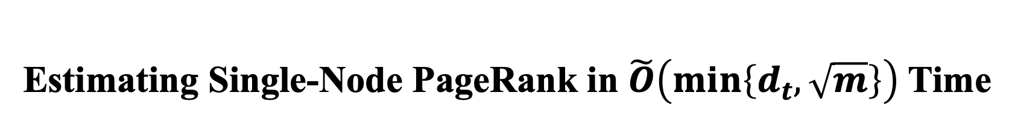
Hanzhi Wang, Zhewei Wei
on undirected graphs !
Estimating Single-Node PageRank in $\tilde{O}\left(min\left\{d_{t},\sqrt{m}\right\}\right)$ Time
Renmin University of China
August 30, 2023
Notes:
Hello everyone. I am Hanzhi Wang from Renmin University [e] of China. It’s my pleasure to present our paper here. This paper was completed under the supervision [ˌsuːpərˈvɪʒ(ə)n] of my adviser, Prof Zhewei Wei. In this paper, we consider the problem of estimating (click) a single node’s pagerank (click!) on undirected graphs. And we have successfully tightened the upper bound for the query time complexity of this problem to (click) the minimum of dt and the square root of m. here dt denotes the degree of the target node t， and m denotes the number of edges in the graph.

Slide 2







PageRank
PageRank was first proposed by Google’s two cofounders to evaluate the importance of each web page in Google’s search engine.
Intuition: a web page is important if:
the page is linked by many other pages;
or the page is linked by some important pages.
Co-founders of Google:
Larry Page, Sergey Brin
The Web Page $u$:
an important page whose contents are worth trusty
$$u$$
Notes:
Before diving into more details of our method, I would like to briefly introduce the definition of pagerank first! Pagerank is actually a very famous, popular, influencial and widely-adopted metric /ˈmetrɪk/ for evaluating node centrality /senˈtræləti/ on graphs. It was first proposed by the cofounders of google in 1998 to calculate the global importance of web pages in google’s search engine. PageRank is defined based on the intuition that a web page is important if this page is linked by many other web pages, or this page is linked by some very important pages. For example, in this toy network, （click）we believe the page u is an important web page,on which the infomration are worth trusty /ˈtrʌsti/ if

Slide 3

PageRank
PageRank was first proposed by Google’s two cofounders to evaluate the importance of each web page in Google’s search engine.
Intuition: a web page is important if:
the page is linked by many other pages;
or the page is linked by some important pages.
Co-founders of Google:
Larry Page, Sergey Brin
$$u$$
Page $u$ is linked by many other pages
Notes:
Page u is linked by many other pages

Slide 4


PageRank
PageRank was first proposed by Google’s two cofounders to evaluate the importance of each web page in Google’s search engine.
Intuition: a web page is important if:
the page is linked by many other pages;
or the page is linked by some important pages.
Co-founders of Google:
Larry Page, Sergey Brin
$$u$$
Page $u$ is linked by an important page $v$.
$$v$$
Notes:
Or if page u is linked by some known to be important web pages, like page v.

Slide 5
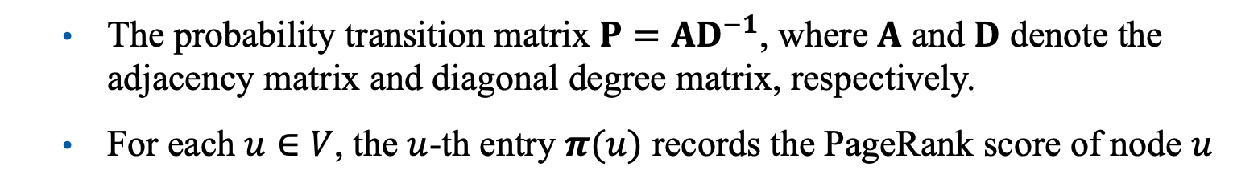

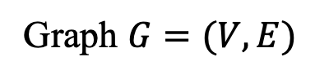
PageRank
Definition formula of the PageRank vector $π$:
$$π=\left(1−α\right)Pπ+α⋅\frac{1}{n}$$
The probability transition matrix $P=AD^{−1}$, where $A$ and $D$ denote the adjacency matrix and diagonal degree matrix, respectively.
For each $u∈V$, the $u$-th entry $π(u)$ records the PageRank score of node $u$
web pages
nodes
links
edges
Web Network
Graph $G=(V,E)$
Notes:
Such intuition of PageRank can be formulated as an iterative /ˈɪtəreɪtɪv/ equation by converting the real-world networks to graph structures. In this iterative equation, the vector pi is called the pagerank vector, whose u-th entry pi(u) records the pagerank score of node u. and the matrix P denotes the transition matrix of the graph, where p inherently /ɪnˈherəntli/ equals the adjacency əˈdʒeɪsənsi/ matrix A times the inverse of the degree matrix D on undirected graphs.

Slide 6

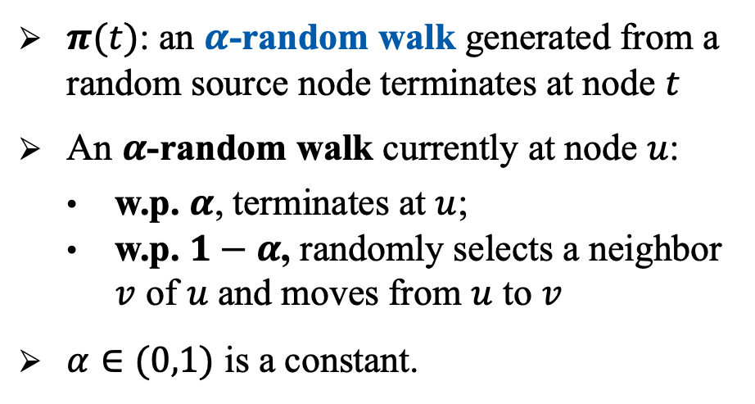
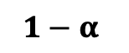
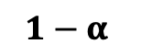
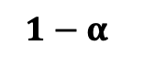
Probabilistic Interpretation
10
9
12
2
$$1−α$$
$$α$$
1
$$1−α$$
8
3
11
4
$$1−α$$
$π(t)$: an $α$-random walk generated from a random source node terminates at node $t$
An $α$-random walk currently at node $u$:
w.p. $α$, terminates at $u$;
w.p. $1−α$, randomly selects a neighbor $v$ of $u$and moves from $u$ to $v$
$α∈(0,1)$ is a constant.
6
5
uniformly select a node in the graph
7
Notes:
On the other hand, the pagerank score of any node t in the graph can be interpretated /ɪnˈtɜːrprətɪd/ as the probability that an alpha-random walk (click!) generated from a random source node in the graph terminates at node t. here the alpha-random walk refers to a specific random walk simulation process that at each step, the walk either terminates w.p. alpha, or moves to a randomly selected neighbor with probability 1 minus alpha. Here alpha is a constant called the damping factor.

Slide 7
Wide Applications
Due to PageRank’s simplicity, uniqueness, generality, guaranteed existence, (and of course, the success that Google achieved), PageRank has become one of the most influential graph meatric over the last decade, with applications that extend far beyond web search.
Information retrieval
Recommender systems
Social networks
Biology
Chemistry
Neuroscience
…
Notes:
Above is a brief introduction to the definition of PageRank. Pagerank was first proposed in 1998, and has become one of the most influential metric /ˈmetrɪk/ on graphs over the last decade due to its simplicity, uniqueness /juˈniːknəs/, generality /ˌdʒenəˈræləti/, guaranteed existence, and of course, the success that Google achieved. Its application has been far beyond the original web search，covering information retrieval， recommender system, social networks, even biology, chemistry, neuroscience and so on.

Slide 8
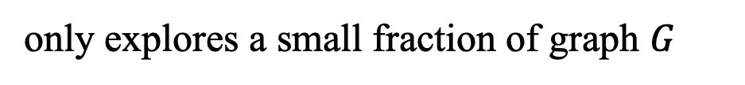
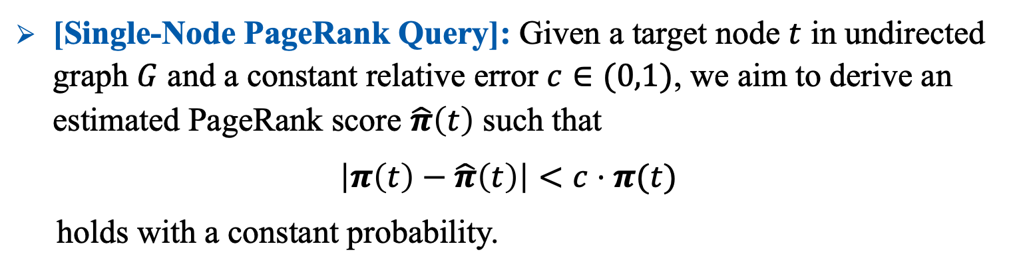
Problem Definition
[Single-Node PageRank Query]: Given a target node $t$ in undirected graph $G$ and a constant relative error $c∈(0,1)$, we aim to derive an estimated PageRank score $\hat{π}\left(t\right)$ such that
$$\left|π\left(t\right)−\hat{π}\left(t\right)\right|<c⋅π(t)$$
holds with a constant probability.
A humble goal: a local algorithm with $o(n)$ query time to derive $\hat{π}\left(t\right)$
only explores a small fraction of graph $G$
Notes:
In this paper, we focus on a fundamental pagerank computation problem, called the single-node PageRank query. In this problem, we are given a target node t in the graph, we aim to estimate the PageRank score of the target node t within constant relative error and constant success probability. In this paper, we only care about undirected graphs.
note that the output of this problem is only one decimal /ˈdesɪm(ə)l/, that is \hat{\pi}(t), the estimated value of node t’s pagerank. thus, (click) we believe a humble goal of this problem is designing a local algorithm whose query time complexity can be sublinear to the number of nodes n. (click) in other words, we hope to design a local algorithm, which only needs to explore a small fraction of the graph.

Slide 9
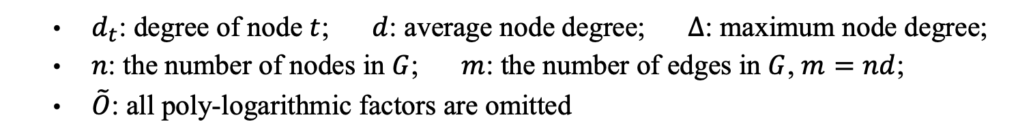
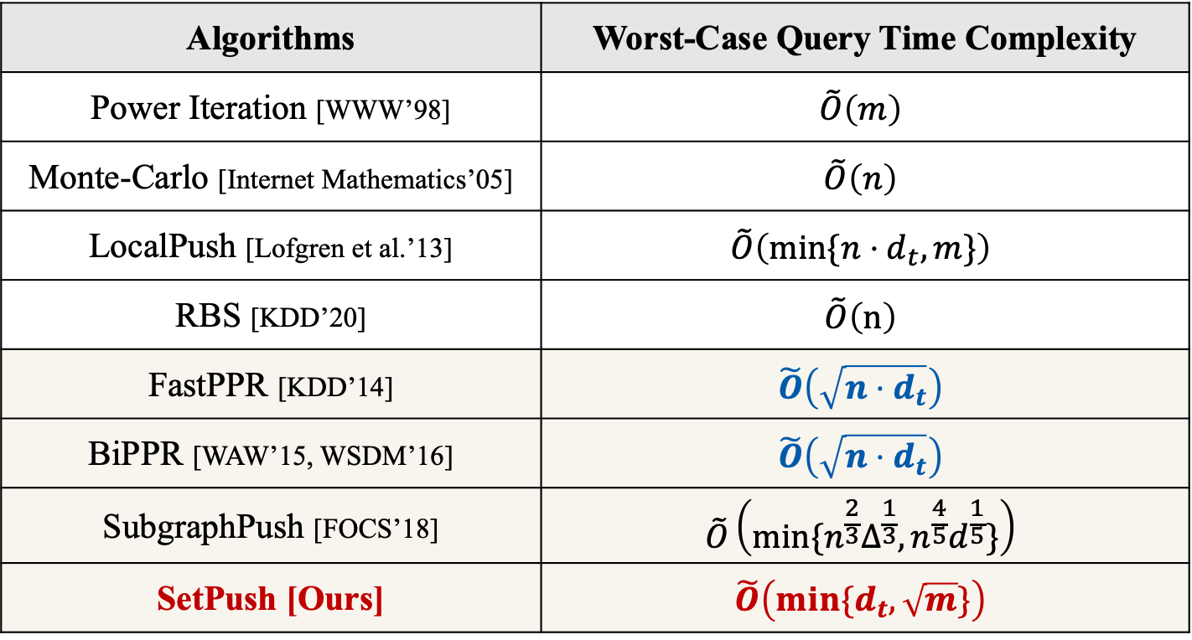
Contributions
Algorithms | Worst-Case Query Time Complexity
Power Iteration [WWW’98] | $$\tilde{O}\left(m\right)$$
Monte-Carlo [Internet Mathematics’05] | $$\tilde{O}\left(n\right)$$
LocalPush [Lofgren et al.’13] | $$\tilde{O}\left(min⁡\{n⋅d_{t}, m\}\right)$$
RBS [KDD’20] | $$\tilde{O}\left(n\right)$$
FastPPR [KDD’14] | $$\tilde{O}\left(\sqrt{n⋅d_{t}}\right)$$
BiPPR [WAW’15, WSDM’16] | $$\tilde{O}\left(\sqrt{n⋅d_{t}}\right)$$
SubgraphPush [FOCS’18] | $$\tilde{O}\left(min⁡\{n^{\frac{2}{3}}Δ^{\frac{1}{3}}, n^{\frac{4}{5}}d^{\frac{1}{5}}\}\right)$$
SetPush [Ours] | $$\tilde{O}\left(min⁡\{d_{t}, \sqrt{m}\}\right)$$
SOTA
SOTA
$d_{t}$: degree of node $t$; $d$: average node degree; $Δ$: maximum node degree;
$n$: the number of nodes in $G$; $m$: the number of edges in $G$, $m=nd$;
$\tilde{O}$: all poly-logarithmic factors are omitted
Notes:
However, even for this humble goal, existing method can seldom /ˈseldəm/ achieve it. For example, in the table, we list the query time complexity of existing methods. We note that only from the fifth line, the query time complexity becomes sublinear to the number of nodes n. In particular, the Fastppr method and the bippr method provide the upper bound for this problem before our paper. They achieve the complexity of the square root of n times dt. In comparison, in this paper, we propose a novel method setpush, which tightens the upper bound to the minimum of dt and the square root of m.

Slide 10
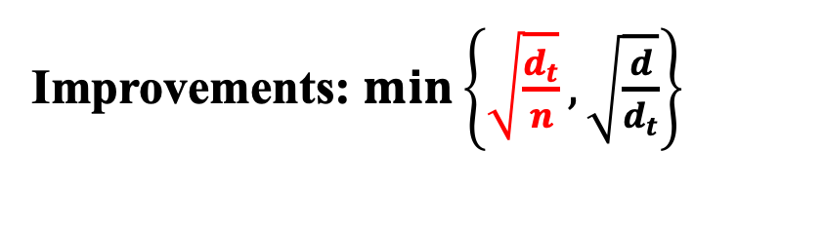
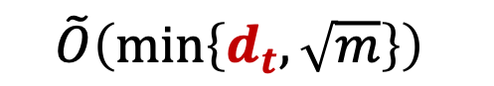

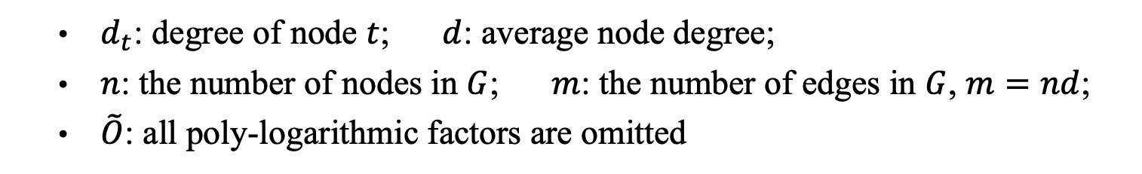
Theoretical Improvements
$d_{t}<n$ always holds
$$\tilde{O}\left(\sqrt{nd_{t}}\right)$$
$$\tilde{O}\left(min\left\{d_{t},\sqrt{m}\right\}\right)$$
SOTA
Our SetPush
Improvements: $\min\left\{\sqrt{\frac{d_{t}}{n}}, \sqrt{\frac{d}{d_{t}}}\right\}$
$d_{t}$: degree of node $t$; $d$: average node degree;
$n$: the number of nodes in $G$; $m$: the number of edges in $G$, $m=nd$;
$\tilde{O}$: all poly-logarithmic factors are omitted
Notes:
To see the theoretical improvement of our setpush, recall that the upper bound before this paper is the square root of n times dt. Since dt denotes the degree of the target node t, which is always smaller than the number of nodes n, our complexity bound is always asymptotically /æsɪmˈtɒtɪklɪ/ better than the previous bound. In particular, (click) for a tiny dt, the improvement of dt over the square root of n times dt is significant.

Slide 11
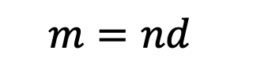
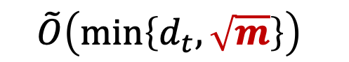
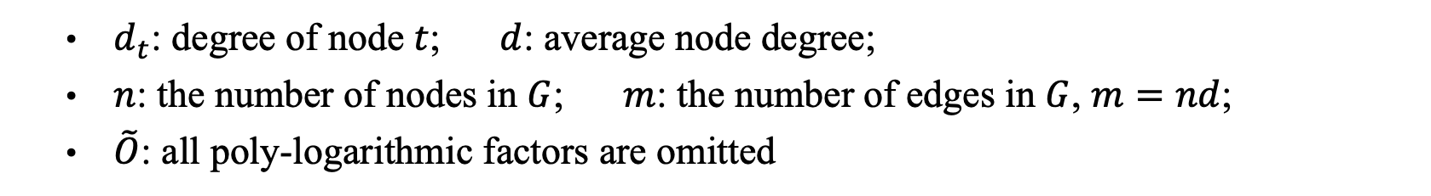
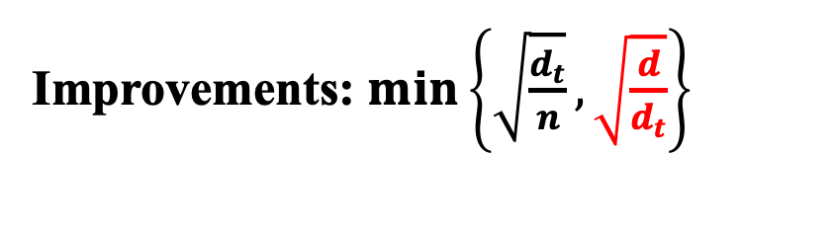
Theoretical Improvements
When $d_{t}$ is large (e.g., $d_{t}>d$): $\sqrt{nd_{t}}<\sqrt{m}$ , since $m=nd$
$$m=nd$$
$$\tilde{O}\left(\sqrt{nd_{t}}\right)$$
$$\tilde{O}\left(min\left\{d_{t},\sqrt{m}\right\}\right)$$
SOTA
Our SetPush
Improvements: $\min\left\{\sqrt{\frac{d_{t}}{n}}, \sqrt{\frac{d}{d_{t}}}\right\}$
$d_{t}$: degree of node $t$; $d$: average node degree;
$n$: the number of nodes in $G$; $m$: the number of edges in $G$, $m=nd$;
$\tilde{O}$: all poly-logarithmic factors are omitted
Notes:
On the other hand, when dt is large (for example when dt is larger than the average node degree d), the square root of m can dominate our complexity bound, where m is the number of edges in the graph and (click) m equals n times d. thus, (click!) for a large dt especially when dt is larger than the average degree d, the larger dt is, the more significant improvement achieved by our setpush is.

Slide 12
Limitations of Existing Methods
Notes:
In the following， i will illustrate the limitations of existing methods， and explain the reason why our setpush can achieve a better complexity bound.

Slide 13

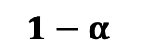
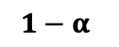
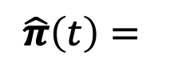

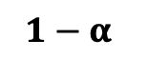
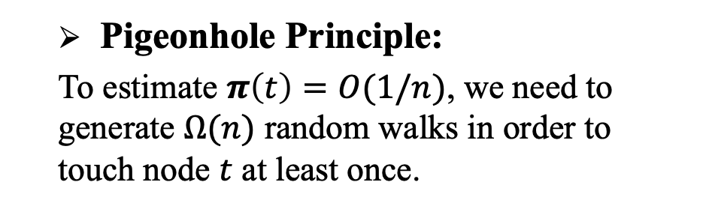
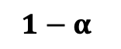
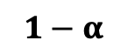


Limitations of Existing Methods
The Monte-Carlo Method [Internet Mathematics’05]
10
9
12
2
$$1−α$$
$$1−α$$
$$α$$
1
$$1−α$$
8
$$1−α$$
11
3
target node
$$α$$
$$1−α$$
$$1−α$$
4
# of $α$-walks terminates at $t$
$$1−α$$
$$\hat{π}\left(t\right)=$$
$$α$$
total # of $α$-walks generated in $G$
6
5
Pigeonhole Principle:
To estimate $π\left(t\right)=O(1/n)$, we need to generate $Ω(n)$ random walks in order to touch node $t$ at least once.
uniformly select a node in the graph
7
Notes:
First, let’s see the limitation of the canonical /kəˈnɑːnɪkl/ monte-carlo method. Recall that the pagerank score of the target node t equals the probability that an alpha random walk generated from a random source node terminates at node t. By this interpretation /ɪnˌtɜːrprəˈteɪʃ(ə)n/, (click!) the monte-carlo method generates multiple alpha random walks on the graph. Each random walk is generated from a random source node. Then the monte-carlo method uses the fraction /ˈfrækʃ(ə)n/ that the number of alpha walks terminates at node t over the total number of random walks generated in the graph as the estimated value of node t's pagerank. Such monte-carlo method is cut out to estimate large pagerank scores. However, for small pagerank like pi(t) equals 1 over n,if we want to derive an estimator of pi(t) within constant relative error, by the pigeonhole /ˈpɪdʒɪnhoʊl/ principle, the monte-carlo method needs to generate no less than n walks to ensure that node t is touched by random walks at least once. Therefore, in the worst case scenario, the query time complexity of the monte-carlo method can not be sublinear to n.

Slide 14
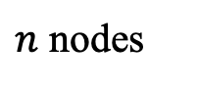


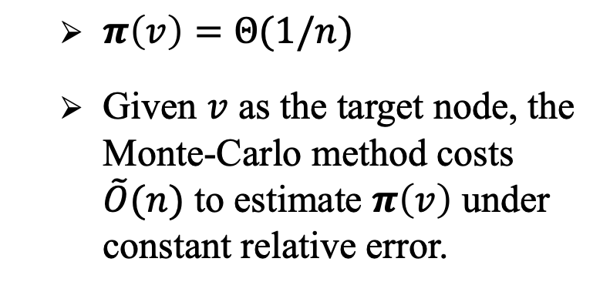
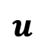
Limitations of Existing Methods
The Monte-Carlo Method [Internet Mathematics’05]
$π\left(v\right)=Θ(1/n)$
Given $v$ as the target node, the Monte-Carlo method costs $\tilde{O}(n)$ to estimate $π\left(v\right)$ under constant relative error.
$$v$$
$n$ nodes
$$u$$
a hard instance for the Monte-Carlo method
$$…$$
$$…$$
Notes:
This slide presents a toy example for such worst-case scenario. If we are given node v as the target node for single-node pagerank query, the Monte-Carlo method has to cost $\tilde{O}\left(n\right)$ time to estimate $π\left(v\right)$.

Slide 15
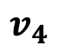
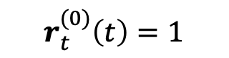
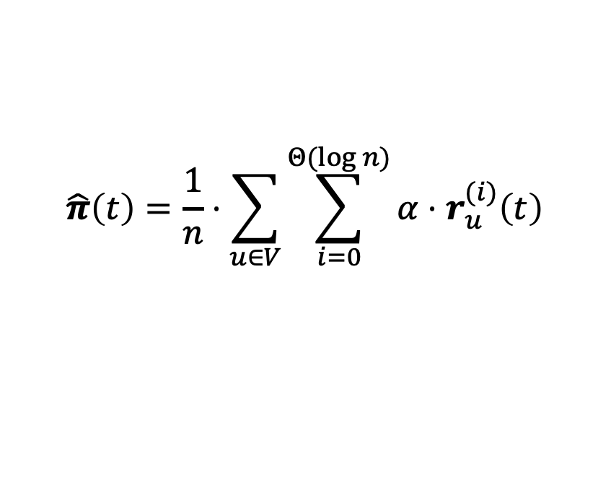

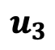
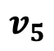
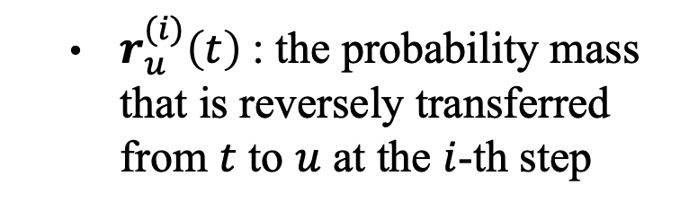
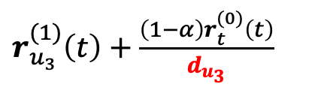
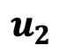
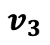
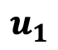

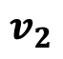
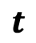
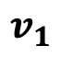
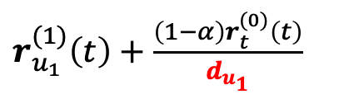
Limitations of Existing Methods
The LocalPush Method [Lofgren et al.’13]
reversely push the probability mass initially at node $t$ to its ancestors
reversely push
$r_{u}^{(i)}\left(t\right)$: the probability mass that is reversely transferred from $t$ to $u$ at the $i$-th step
$r_{u_{1}}^{(1)}\left(t\right)+\frac{\left(1−α\right)r_{t}^{(0)}\left(t\right)}{d_{u_{1}}}$
$$v_{1}$$
$$u_{1}$$
$$v_{2}$$
$r_{u_{3}}^{(1)}\left(t\right)+\frac{\left(1−α\right)r_{t}^{(0)}\left(t\right)}{d_{u_{3}}}$
$$r_{t}^{(0)}\left(t\right)=1$$
$$v_{3}$$
$$u_{2}$$
$$t$$
$$\hat{π}\left(t\right)=\frac{1}{n}⋅\sum_{u∈V}{\sum_{i=0}^{Θ(\log{n})}{α⋅r_{u}^{(i)}\left(t\right)}}$$
$$v_{4}$$
$$u_{3}$$
$r_{u_{3}}^{(1)}\left(t\right)+\frac{\left(1−α\right)r_{t}^{(0)}\left(t\right)}{d_{u_{3}}}$
$$v_{5}$$
Notes:
Another line of research estimates pi(t) by reversely pushing the probability mass from the target node t to its ancestors /ˈænsestər/. More specifically, (click!) this line of research maintains a variable r_u(t) for each node u in the graph, which records the probability mass that has been reversely transferred from the target node t to the node u. In particular, r^i_u(t) records the probability mass transferred from node t to node u at the i-th push step. Initially, (click) these push methods set r zero t(t) as 1, referring to that we put 1 unit /ˈjuːnɪt/ of probability mass at node t initially.(click)Then during the push process，each node u with nonzero r_u（t）transfers its probability mass to its neighbors according to the transition probability. (click)Finally, we return the average of r^i_u(t) over all nodes u and all steps i as the estimator of pi(t).

Slide 16
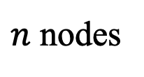

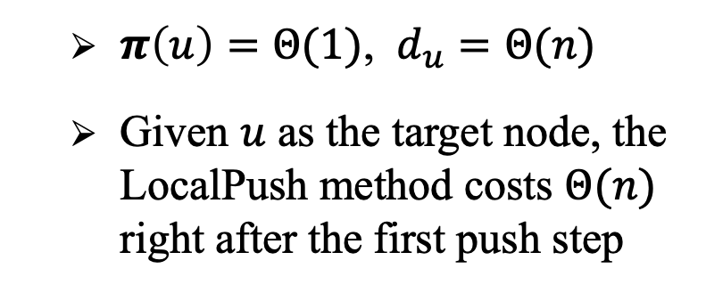

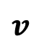
Limitations of Existing Methods
The LocalPush Method [Lofgren et al.’13]
$π\left(u\right)=Θ(1)$, $d_{u}=Θ(n)$
Given $u$ as the target node, the LocalPush method costs $Θ(n)$ right after the first push step
$$v$$
$n$ nodes
$$u$$
$$…$$
$$…$$
a hard instance for the LocalPush method
Notes:
The push method is cut out to estimate small pi(t) since we reversely push the probability mass from t to its ancestors. However, a hard instance for these push methods is to push probability mass from a large-degree node. for example, as shown in the toy graph, when we are given node u as the target node for the single-node pagerank query, the push method costs $O(n)$ time even after the first push step because the degree of node u is n. As a result, these push methods still cannot achieve a sublinear query time complexity for an arbitrary /ˈɑːrbɪtreri/ target node in the worst-case scenario.

Slide 17
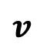

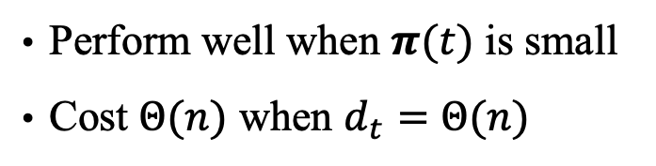
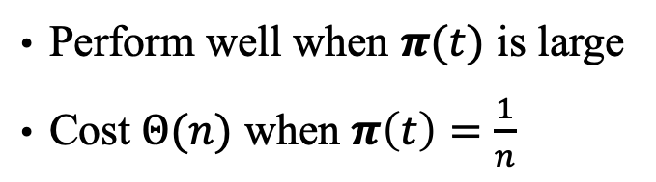

Limitations of Existing Methods
FastPPR [KDD’14], BiPPR [WSDM’16], SubgraphPush [FOCS’18]
forward random walk
reversely push
Perform well when $π(t)$ is large
Cost $Θ(n)$ when $π\left(t\right)=\frac{1}{n}$
Perform well when $π(t)$ is small
Cost $Θ(n)$ when $d_{t}=Θ(n)$
$$v$$
$$t$$
$$…$$
$$…$$
Notes:
Recently, a set of works propose to combine the monte-carlo method and the push method in an effective way. The rationale /ˌræʃəˈnæl/ behind these hybrid methods is that the monte-carlo method and the push method have complementary advantages. The monte-carlo method generates forward random walks in the graph, which performs well when pi(t) is large. The push method reversely push probability mass from the target noe t, which can efficiently estimate small pi（t）. However, these hybrid methods can only relieve the limitations of monte-carlo and the push methods. In the worst-case scenario, the push operation still costs O(n) time right after the first push step, leading to inefficient query cost.

Slide 18
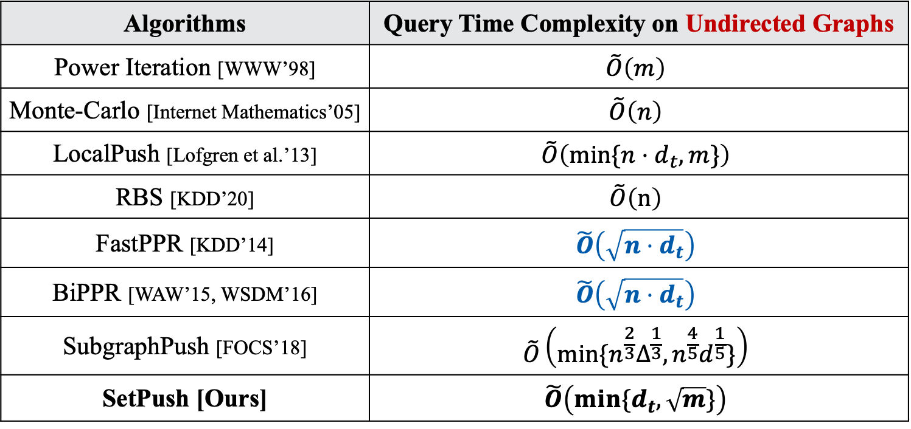
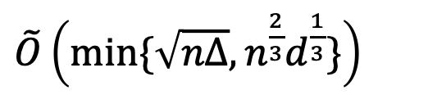
Limitations of Existing Methods
Algorithms | Query Time Complexity on Undirected Graphs
Power Iteration [WWW’98] | $$\tilde{O}\left(m\right)$$
Monte-Carlo [Internet Mathematics’05] | $$\tilde{O}\left(n\right)$$
LocalPush [Lofgren et al.’13] | $$\tilde{O}\left(min⁡\{n⋅d_{t}, m\}\right)$$
RBS [KDD’20] | $$\tilde{O}\left(n\right)$$
FastPPR [KDD’14] | $$\tilde{O}\left(\sqrt{n⋅d_{t}}\right)$$
BiPPR [WAW’15, WSDM’16] | $$\tilde{O}\left(\sqrt{n⋅d_{t}}\right)$$
SubgraphPush [FOCS’18] | $$\tilde{O}\left(min⁡\{n^{\frac{2}{3}}Δ^{\frac{1}{3}}, n^{\frac{4}{5}}d^{\frac{1}{5}}\}\right)$$
SetPush [Ours] | $$\tilde{O}\left(min⁡\{d_{t}, \sqrt{m}\}\right)$$
SOTA
SOTA
asymptotically better:
Query time’s lower bound on directed graph:
$\tilde{O}\left(min⁡\{\sqrt{nΔ}, n^{\frac{2}{3}}d^{\frac{1}{3}}\}\right)$
$d_{t}$: degree of node $t$; $d$: average node degree; $Δ$: maximum node degree;
Notes:
In addition, recall that this paper focuses on the single-node pagerank query on undirected graphs，and the upper bound before our paper is the square root of n times dt。 In comparsion， for the problem of estimating a single node’s pagerank on directed graphs， a proved lower bound is given here (click)， where delta denotes the maximum node degree in the graph. We note that the lower bound on directed graphs is even larger than the upper bound on undirected graphs. This is because there are some nice property /ˈprɑːpərti/ of pagerank held only on undirected graphs. However, most of existing methods do not well utilize these property, resulting in inefficient query complexity.

Slide 19
Our SetPush Algorithm
Notes:
Next, I will present the details of our setpush algorithm and explain the superiority /suːˌpɪriˈɔːrəti/ of our setpush over existing methods.

Slide 20




Our SetPush Algorithm
Algorithm Structure:
Push probability mass from the target node $t$ in a forward fashion;
randomized forwad push
Superiority of SetPush:
Dedicately utilize the symmetry of random walk probabilities on undirected graphs;
For large-degree nodes, only sample a small fraction of neighbors to push probability.
$$v$$
Enable us to do forward push
$$t$$
$$…$$
$$…$$
Avoid the $Θ(n)$ term introduced by the push method for large-degree nodes
Notes:
As an overview of our setpush algorithm, we follow the push structure adopted in existing push methods to push probability mass from the target node t step by step. However, a major difference between our setpush and existing reverse push methods is, we push the probability mass from the target node t in a forward fashion by utilizing the symmetry /ˈsɪmətri/ of random walk probabilities on undirected graphs. Moreover, we design a novel randomized push operation, which only samples a small fraction of neighbors to push probability for large-degree nodes. Such push operation enables us to avoid the O(n) term introduced by the original push operation for large degree nodes.

Slide 21




Superiority of Our SetPush Algorithm
Symmetry of random walk probabilities on undirected graphs;
$π_{s}\left(t\right)⋅d_{s}=π_{t}\left(s\right)⋅d_{t}$,
for $∀s,t∈V$
The probability that an $α$-walk generated from $s$ terminates at $t$
The probability that an $α$-walk generated from $t$ terminates at $s$
Notes:
To see the details of our setpush, a core idea of our method is to utilize the symmetry /ˈsɪmətri/ of random walk probabilities on undirected graphs. To be more specific, for any two nodes s and t in the graph, the random walk probability from $s$ to $t$ equals the random probability from node t to s with a multiplication of dt over ds. Such symmetry is very intuitive.

Slide 22















Superiority of Our SetPush Algorithm
Symmetry of random walk probabilities on undirected graphs;
$π_{s}\left(t\right)⋅d_{s}=π_{t}\left(s\right)⋅d_{t}$,
for $∀s,t∈V$
The probability that an $α$-walk generated from $s$ terminates at $t$
The probability that an $α$-walk generated from $t$ terminates at $s$
$$…$$
Path A:
$$s$$
$$u$$
$$v$$
$$…$$
$$w$$
$$t$$
generating an $α$-walk from $s$ to $t$ via path A
$$\frac{(1−α)}{d_{s}}$$
$$⋅ \frac{(1−α)}{d_{u}}$$
$$⋅ \frac{(1−α)}{d_{v}}$$
$$⋅ \frac{(1−α)}{d_{w}}$$
Pr
$$=$$
$$…$$
$$⋅ α$$
Notes:
Consider a specific random walk path from node s to t, (click) the probability of walking from s to t via this path is 1 devided by ds, du, dv, and finally dw.

Slide 23














Superiority of Our SetPush Algorithm
Symmetry of random walk probabilities on undirected graphs;
$π_{s}\left(t\right)⋅d_{s}=π_{t}\left(s\right)⋅d_{t}$,
for $∀s,t∈V$
The probability that an $α$-walk generated from $s$ terminates at $t$
The probability that an $α$-walk generated from $t$ terminates at $s$
$$…$$
Path A:
$$s$$
$$u$$
$$v$$
$$…$$
$$w$$
$$t$$
generating an $α$-walk from $s$ to $t$ via path A
$$\frac{(1−α)}{d_{s}}$$
$$⋅ \frac{(1−α)}{d_{u}}$$
$$⋅ \frac{(1−α)}{d_{v}}$$
$$⋅ \frac{(1−α)}{d_{w}}$$
Pr
$$=$$
$$…$$
$$⋅ α$$
generating an $α$-walk from $t$ to $s$ via path A
$$⋅ \frac{(1−α)}{d_{u}}$$
$$⋅ \frac{(1−α)}{d_{v}}$$
$$⋅ \frac{(1−α)}{d_{w}}$$
$$⋅ \frac{(1−α)}{d_{t}}$$
Pr
$$=$$
$$α$$
$$…$$
Notes:
In comparison /kəmˈpærɪsn/, (click!) the probability of walking from t to s via this path is 1 devided by dt, dw, then dv, and finally du. We note that the denominators /dɪˈnɑːmɪneɪtər/ of these two probabilities are nearly the same, except the first one is devided by ds, while the second one is devided by dt. This actually gives the symmetry /ˈsɪmətri/ of random walk probabilities on undirected graphs

Slide 24







Superiority of Our SetPush Algorithm
Target node $t$’s PageRank
randomized forwad push
$π\left(t\right)=\frac{1}{n}⋅\sum_{u∈V}{π_{u}(t)}$
$$v$$
The probability that an $α$-walk generated from $u$ terminates at $t$
$$t$$
$=\frac{1}{n}⋅\sum_{u∈V}{{\frac{d_{t}}{d_{u}}⋅π}_{t}(u)}$
The probability that an $α$-walk generated from $t$ terminates at $u$
Notes:
By utilizing this symmetry /ˈsɪmətri/, we estimate pi(t) by calculating the random walk probability from the target node t to all the other nodes u, instead of the random walk probability from all the other nodes u to the target node t.

Slide 25





Superiority of Our SetPush Algorithm
For small-degree nodes:
Deterministically push probability mass to all neighbors
$$v$$
$$u$$
$r_{t}^{\left(i+1\right)}\left(v\right)+\frac{\left(1−α\right)⋅r_{t}^{\left(i\right)}(u)}{d_{u}}$
$$r_{t}^{\left(i\right)}(u)$$
If $d_{u}<\left(1−α\right)⋅r_{t}^{\left(i\right)}(u)/θ$:
Push probability mass from $u$ to every neighbor $v∈N(u)$
$r_{t}^{\left(i+1\right)}\left(v\right)←r_{t}^{\left(i+1\right)}\left(v\right)+\frac{\left(1−α\right)⋅r_{t}^{\left(i\right)}(u)}{d_{u}}$
Notes:
And for small degree nodes, (click)we adopt the original push method to transfer probability mass in a forward way.

Slide 26






Superiority of Our SetPush Algorithm
For large-degree nodes:
Sample a small fraction of neighbors to push probability mass
$r_{t}^{\left(i+1\right)}\left(v\right)+θ,$w.p. $\frac{\left(1−α\right)⋅r_{t}^{\left(i\right)}(u)}{θ⋅d_{u}}$
$$v$$
If $d_{u}>\left(1−α\right)⋅r_{t}^{\left(i\right)}(u)/θ$:
Independently sample each neighbor $v∈N(u)$ w.p. $\frac{\left(1−α\right)⋅r_{t}^{\left(i\right)}(u)}{θ⋅d_{u}}$
Push probability mass from $u$ to those sampled neighbor $v$
$r_{t}^{\left(i+1\right)}\left(v\right)←r_{t}^{\left(i+1\right)}\left(v\right)+θ$
$$r_{t}^{\left(i\right)}(u)$$
$$u$$
the expected increment is still $\frac{\left(1−α\right)⋅r_{t}^{\left(i\right)}(u)}{θ⋅d_{u}}⋅θ=\frac{\left(1−α\right)⋅r_{t}^{\left(i\right)}(u)}{d_{u}}$
Notes:
on the other hand, for large degree nodes, (click)we only sample a small fraction /ˈfrækʃ(ə)n/ of neighbors to push probability mass. Specifically, for the large-degree node u, we only sample some neighbors from u’s adjacency list to touch. Each neighbor is independently sampled with probability r_t(u) over theta times du, where theta is an error parameter. For those sampled neighbor v, we increase r_t(v) by theta. By this means the expected increment is still the same to that of the deterministic push.

Slide 27

Experiments
Datasets
Datasets | # of nodes $n$ | # of edges $m$
Youtube (YT) | 1,138,499 | 5,980,886
IndoChina (IC) | 7,414,768 | 301,969,638
Orkut-Links (OL) | 3,072,441 | 234,369,798
Friendster (fr) | 68,349,466 | 3,623,698,684
Notes:
Above is the high-level idea of our method. We also conduct extensive experiments to evaluate the effectiveness of our method. In our experiments, we use four real-world large graphs, whose information are listed here.

Slide 28


Experiments
Query Time
Samle the target node uniformly at random in $G$
Our SetPush
Our SetPush
Our SetPush
Our SetPush
Query Time
Sample the target node according to the node degree distribution
Notes:
The experimental results show that our setpush costs the minimum query time over all existing methods, no matter the target node t is uniformly sampled in the graph, or is sampled according to the node degree distribution.

Slide 29

Conclusion & Open Problem
1
Summary
Our SetPush answers the single-node PageRank query on undirected graphs with the worst-case query time complexity of $\tilde{O}\left(min \left\{d_{t},\sqrt{m }\right\}\right)$.
The superiority of SetPush mainly comes from two aspects:
utilize the symmetry of random walk probability on undirected graphs;
only sample a small fraction of neighbors to push mass.
2
Open Problem
What is the lower bound for the worst-case query time complexity to answer the single-node PageRank query on undirected graphs?
Notes:
In conclusion, in this paper we consider the problem of estimating a single node’s pagerank on undirected graphs. We successfully tighten the upper bound for this problem by utilizing the symmetry of random walk probabilities on undirected graphs. a novel randomized push operation is proposed to avoid touch all neighbors during the push operation from large-degree nodes. I would like to use an open problem to end this talk。Since we have successfully tightened the upper bound to the minimum of dt and the square root of m。 A natural question is： have we already achieved the optimal complexity or not。what is the lower bound for the single-node pagerank query on undirected graphs？For now， the lower bound is still unclear。
That’s all of my presentation. Thank you。 Any questions?

